Slide 1
Is B2B marketing automation still actual?
DRD. Codrin Teiu
Alexandru Ioan Cuza University of Iasi

Slide 2
What is a Management Information System?
Type of information system for organizations (companies)
Allows them to take control over their data
Organize, analyze, visualize, access control,
Decision making

Slide 3
EVOLUTION
Mainframe
<1965
IBM was king
Computers big as rooms
Personal Computers
1965=micro-processor is discovered
Low cost computers from IBM and APPLE comes into the stage
Client Server Networks
Intranet
Networks of interconnected computers within a company, managed by a server
Enterprise computing
The speeds of computer networks increased dramatically
Software systems is designed around the needs of the company, not the ones of the users
Cloud computing
Present day
1998- DPA
App delivery and storage independent of location or hardware;
1978 – Thuerk, first campaign, 400 emails, Arpanet,13 mil
1990 - hotmail
2003-CanSpam
2004- SPF
2007 - Iphone

Slide 4
Types of MIS
CRM
HRM
Customer relationship management
AIS
Accounting information systems
DSS
OAS
Decision support systems

Slide 5
Marketing automation Systems (MAS)
Marketing automation systems (MAS) are today considered to be part of the CRM software family, due to some of the similarities in scope. In most measure, they are rather complementary than overlapping.
MAS would come to support CRM by automating marketing processes in the digital marketing area thus supplying CRM systems the so much desired sales leads.

Slide 6
Marketing automation systems
Perspective | Definition
Operational | Marketing automation is a software tool used to support operational efforts when creating structure around a marketing campaign.
Strategic | Core strategic element is managing client relations.

Slide 7
MAS components
Email marketing | Marketing campaign management | Web/Social media marketing | Leads management | Reporting and analysis
With the purpose to inform, personalize content and report on it | Email marketing campaigns | Dynamic content and content creation Landing pages and forms, websites and social media | Database segmentation Lead nurture CRM integration | Data collection Reports

Slide 8
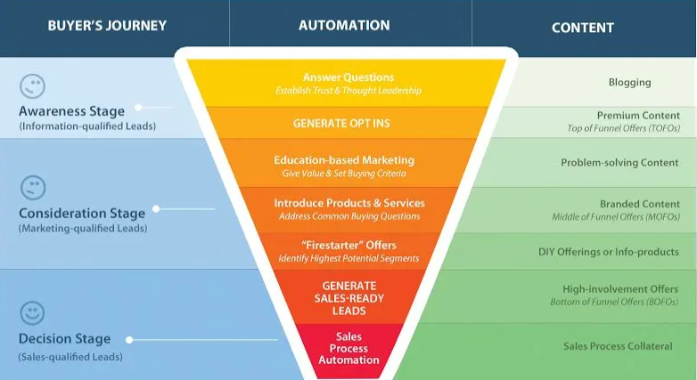
Buyers journey funnel (Hubspot, 2018)

Slide 9
Question
The main question which we are looking to answer is whether email marketing usage in the B2B sector is increasing or decreasing in the context of the rise of the presence of companies is social media.
I believe a good indicator for this question is gauging the size of the databases used in email marketing in correlation with the number of sent emails and platforms used. Given that all these are paid items, an increase or decrease would directly tie to the budget invested in this marketing path.

Slide 10
COMMENTS
Actual references?
What is the distribution of the companies?
GDPR?
Evidence for ascending trend conclusion
Implying that the increase of decrease of this field is about the number of emails sent to one contact and the “happiness” of them receive these emails

Slide 11
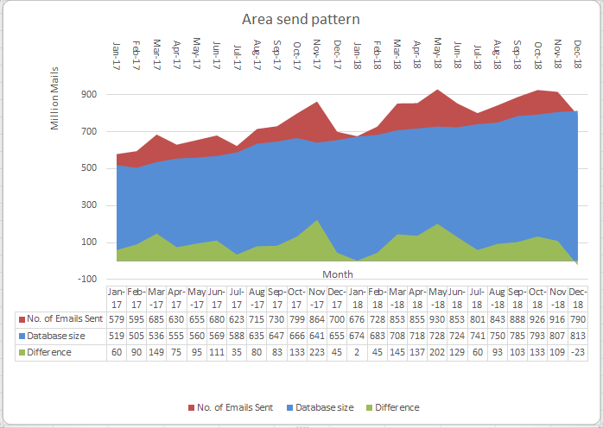

Slide 12
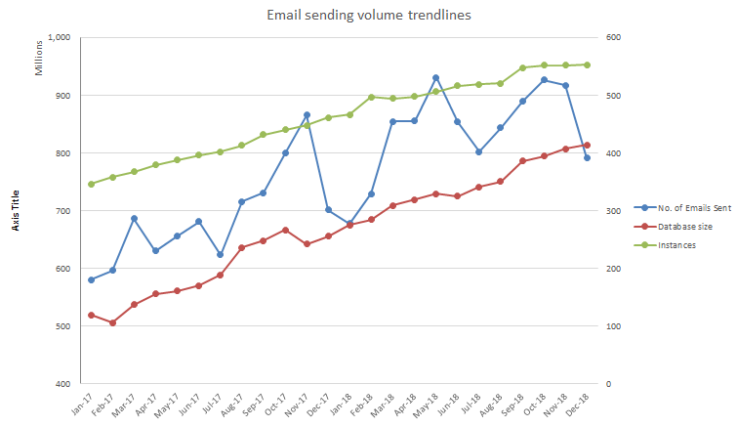
Oracle, 2017 to 2019 sending volume

Slide 13
THANK YOU!

